Slide 1
Self-Learning Ontologies
Presented to the 25th Soar Workshop
Ann Arbor, MI
June 15-17, 2005
Tim Darr, Ph. D.
University of Michigan AI Lab ‘96

Slide 2
Introduction – 21st Century Technologies
R&D company in Austin, TX
  40 employees and growing
  50% of employees hold MS or PhD in Math, CS, or EE
  First major contract award in 1998
Much of our work has been done under contract for
  US Army
  USAF
  ONR
  Intelligence Community
  Defense Advanced Research Projects Agency (DARPA)
  Department of Homeland Security (DHS)
Founders
  Sherry Marcus, Ph.D., MIT
  Darrin Taylor, Sc.D., MIT

Slide 3

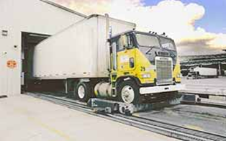
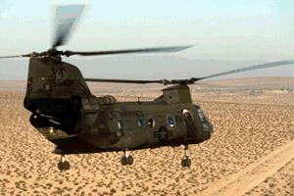
Introduction –21st Century Technologies
Core Competencies
  Link Analysis
  Graph-based pattern recognition
  Social network analysis (SNA)
  Statistical Pattern Recognition
  Data mining
  Predictive planning
  Natural Language Processing and Text Extraction
  Fielded Applications for:
    Defense
    Intelligence
    Homeland security

Slide 4
Definition of Link Analysis
Link Analysis is about Making Connections that represent Meaningful Links between Data Elements to detect Complex Relational Structures indicative of Patterns of Interest.
Pattern #1
Learned Pattern #3
Patterns:
Cargo being shipped
From country that does not
produce said cargo
Pattern of Shipment Changes
Commodity has a new
“notify party”
For just one shipment.
DSB Study on Transnational Threats: making of connections between otherwise meaningless bits of information is at the core of (transnational) threat analysis.”
Inferred Pattern #2
Connecting the Dots is Easy;
Deciding Which Dots to Connect Is Hard

Slide 5
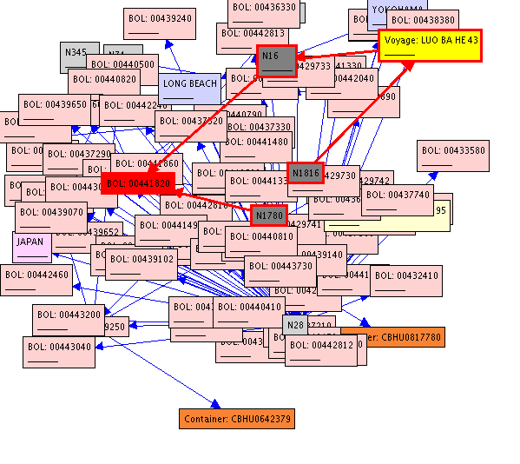
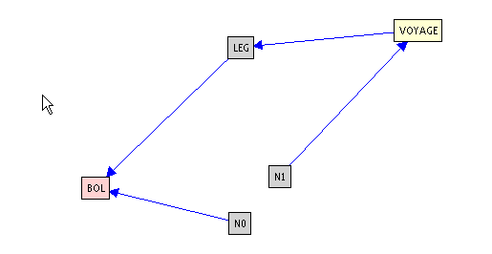
Graph-Based Pattern Recognition
Nodes represent things
  People, organizations, objects, events, alerts, packets, etc.
Edges represent relationships
  Communication, friend, participant, owner, etc.
Graph Pattern
Given:
  A pattern graph that defines a threat
  An evidence graph that records observed activity
Graph matching lets you
  Correlate events to quickly isolate true threats from normal activity
  Develop higher-level situational awareness
Graph Match

Slide 6
Social Network Analysis (SNA)
Originally formulated for human social interaction
Metric values for normal and abnormal behavior are usually different
  We can use metric values to classify observed activity
    Average path length
    “Ring-like-ness”
    Centrality / betweenness of nodes
    Clique-ish-ness
Many reasons for “abnormal” social behavior
  Dysfunctional organization
  Covert organization
    Legitimate
    Terrorist
    Criminal
  Unexpected organization
    Terrorist activity within normal human social activity
    Coordinated attacks within normal network activity

Slide 7
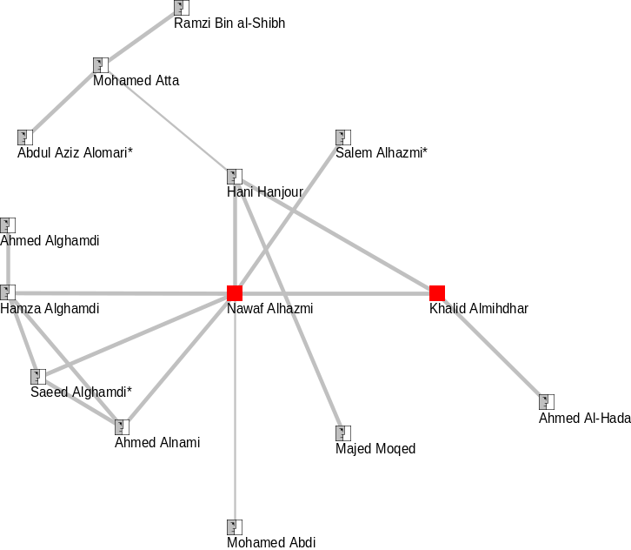
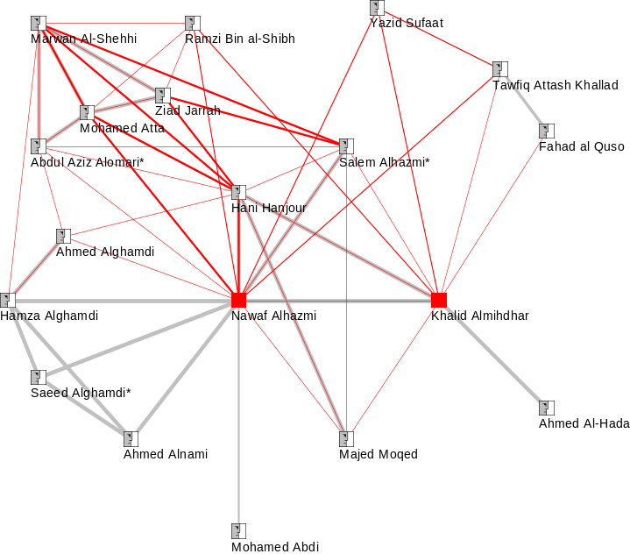
Dormant vs. Active Networks
Dormant 911 Network
(around 2 suspects)
Active 911 Network
(around 2 suspects)
Approach:
  Calculate Salient Social Metrics from data.
  Use Social Network Analysis (SNA) to identify threat signatures.
  This method would have been successful in detecting active 911 network.
Observable Social Metrics:
  Group size: 15  19
  Link Count: 20  49
  Density: 19%  29%
  Path Length: 2.6  1.9
  Closed Trios: 41%  60%
  Appearance of Hubs
Notes:
Hot Link
1. Center of either graph -> TIE2 Search Space Size Reduction

Slide 8
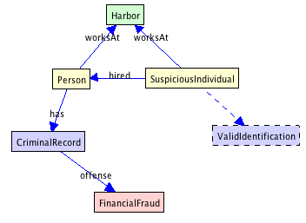
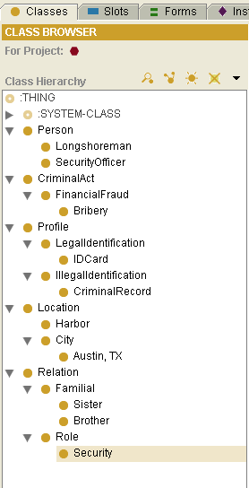
Ontologies in Graph Matching
Traditional Ontologies
  Define type-subtype relationships with multiple inheritance
  Patterns refer to general event types instead of specific events
Generic threat pattern
  Ontologies provide linkage between observed data and patterns of interest
Observed data “Bribery”
isa “FinancialFraud”,
so will match.
Terrorist Ontology

Slide 9
What is a “Self-Learning” Ontology?
Advanced ontologies to provide more powerful ontological capabilities
Ontologies based on cognitive systems
  Domain-specific ontologies
    Terrorists, terror groups, methods of financing
  Ontologies as domain experts
  Learn new patterns of behavior
    Social network analysis
Declarative representations
  Encode knowledge in a declarative form
  Infer categorization of entities
  Easily respond to new facts
    Streaming data ingest
Ontology fusion
  Fuse multiple representations
  Inference over fused representations
  Take advantage of strengths of different ontological representations and inference mechanisms

Slide 10
Evaluation
Golden Nuggets
  None
Coal
  No working system - YET
For further evaluation or questions contact:
  Dr. Tim Darr
    tdarr@21technologies.com
  Dr. Seth Greenblatt
    sgreenblatt@21technologies.com

